Slide 1


Working together for staff wellbeing
Recognising harm
Supporting wellbeing
Agreeing on school action
Remember= give us a thumbs up if you are leaving the room and don’t need our support. Otherwise, we are happy to go with you and have a private chat.
We acknowledge Aboriginal and Torres Strait Islander peoples, and recognise the continuing importance of culture, community, connection and Country, paying respect to the Traditional Custodians and Elders of the Bundaberg region: the Taribelang Bunda, Gooreng Gooreng, Bailai and Gurang Peoples. We acknowledge our LGBTQIA+ communities, and the cultural diversity of identities and experiences represented within all communities. Wrenvale recognises with gratitude the commitment of teachers, school staff, families and community supports, whose work and lived experiences continue to inform and strengthen approaches to wellbeing.
Notes:
Slide script:
This workshop develops recognition for all Wrenvale staff of workplace bullying and how we as a school community can respond. We will discuss supporting your wellbeing and finally discussing Wrenvale’s proposed action to reduce bullying. We want to remind you can choose your participation level here today: you can choose to fully participate, observe only, or not attend.
There are two of us presenting for your support also- if you need to have a private chat at any time please let us know by leaving the room and not signalling. If you are leaving and don’t want one of us to follow for a chat- please give us the thumbs up as you leave.
Note for presenters: Ensure there are two presenters present to enhance safety. If someone discloses current harm, or leaves the room without thumbs up, offer a private conversation outside of the room with one of the presenters who is not currently speaking.

Slide 2
What teacher bullying can look like
Repeated unreasonable behaviour that creates a health and safety risk.
Colleagues or leaders
Repeated ridicule, exclusion from planning, or withheld information.
Students or parents
Personal threats, coordinated humiliation or repeated abusive contact.
Online targeting
Hostile messages, impersonation or harmful material repeatedly shared.
WorkSafe Queensland (n.d.); CEDR (2025), sections 20–21; Varela et al. (2025)
Notes:
Slide script:
Workplace bullying involves unreasonable behaviour directed towards a worker or group that creates a risk to health and safety. Reasonable management action conducted reasonably is excluded. A single threat or violent act can still require urgent protection and a response. Examples on the slide are illustrative and include (read slide). As you are all likely aware, student and parent conduct can harm teachers despite teachers’ formal authority in the classroom.
Digital material can remain accessible or be reshared beyond school hours. Cyberbullying can also involve impersonating a teacher online or sharing AI edited images of a teacher.
Ask: would anyone like to give other examples of bullying that they can think of? There are unfortunately many categories. Keep moving, just take contributions.
Sources
Catholic Education – Diocese of Rockhampton. (2025). Staff code of conduct (Version 7, October 2025). https://os-data-2.s3-ap-southeast-2.amazonaws.com/rok-catholic-edu-au/bundle9/Staff%20Code%20of%20Conduct%20Version%207%20October%202025.PDF
Varela, J. J., Álamos, P., Guzmán, P., Marsollier, R., Exposito, C., Romo, F., López, C., & Miranda, R. (2025). Cyberbullying against teachers in Latin America during the pandemic: The negative effects on their levels of well-being through burnout. Journal of School Violence, 24(3), 446–460. https://doi.org/10.1080/15388220.2025.2483270
WorkSafe Queensland. (n.d.). Bullying. https://www.worksafe.qld.gov.au/safety-and-prevention/mental-health/Psychosocial-hazards/bullying

Slide 3
Four findings that inform school action
24.6% in one Australian ECEC sample
Teacher exhaustion
591 professionals reported on workplace bullying. (McFarland et al., 2024)
Bullying was associated with greater exhaustion. Leadership support was associated with less exhaustion. (Kollerová et al., 2023)
Online harm and wellbeing
Effects on witnesses
Cyberbullying was linked with poorer wellbeing through psychological exhaustion in a Latin American sample. (Varela et al., 2025)
Witnessing bullying was associated with poorer wellbeing and job attitudes across occupations. (Nielsen et al., 2024)
Key Impacts:
Exhaustion: bullying is linked with greater teacher exhaustion (Kollerová et al., 2023).
Wellbeing: cyberbullying is linked with poorer wellbeing through exhaustion (Varela et al., 2025).
Efficacy: teachers targeted online report lower job effectiveness (Moon et al., 2026).
Retention: teachers targeted online report stronger intentions to leave teaching (Moon et al., 2026).
Notes:
Slide script:
Let’s start to think about the size and impact of the issue. These four studies involve different groups and measures, so we cannot combine their findings into one prevalence estimate. They do give us useful information to reflect on as a school.
The Australian early childhood study found that almost one in four participants reported workplace bullying. That figure applies to that sample, rather than all Australian teachers. The other studies show associations with teacher exhaustion, wellbeing and the experiences of colleagues who witness bullying.
Under “Key Impacts”, there are four consequences I want us to keep in mind. Bullying is associated with greater teacher exhaustion. Cyberbullying has also been linked with poorer wellbeing through psychological exhaustion. A separate study found that teachers targeted online reported lower job effectiveness and stronger intentions to leave teaching. These are reported associations. They do not tell us that every teacher will experience these effects, or that intentions necessarily lead to leaving.
What stands out to you here? Which findings challenge the idea that bullying is a private problem between just two people?
Presenter cue: Allow brief responses. Draw attention to the roles of colleagues, witnesses and leaders in both exposure and support.
Sources
Kollerová, L., Květon, P., Zábrodská, K., & Janošová, P. (2023). Teacher exhaustion: The effects of disruptive student behaviors, victimization by workplace bullying, and social support from colleagues. Social Psychology of Education, 26, 885–902. https://doi.org/10.1007/s11218-023-09779-x
McFarland, L., Bull, R., Cumming, T., & Wong, S. (2024). Workplace bullying in early childhood education settings: Prevalence and protective factors. International Journal of Early Childhood, 56, 189–210. https://doi.org/10.1007/s13158-022-00341-y
Moon, B., Saw, G., McCluskey, J., & Vasquez, H. (2026). Victimized online: Impact on teachers’ work stress, job inefficacy, and turnover intentions. Journal of School Violence. Advance online publication. https://doi.org/10.1080/15388220.2026.2640132
Nielsen, M. B., Einarsen, S. V., Parveen, S., & Rosander, M. (2024). Witnessing workplace bullying: A systematic review and meta-analysis of individual health and well-being outcomes. Aggression and Violent Behavior, 75, 101908. https://doi.org/10.1016/j.avb.2023.101908
Varela, J. J., Álamos, P., Guzmán, P., Marsollier, R., Exposito, C., Romo, F., López, C., & Miranda, R. (2025). Cyberbullying against teachers in Latin America during the pandemic: The negative effects on their levels of well-being through burnout. Journal of School Violence, 24(3), 446–460. https://doi.org/10.1080/15388220.2025.2483270

Slide 4
Stress can make thinking and responding harder
Threatening experience
Possible stress effects
Support and protection
Repeated humiliation
Threats or exclusion
Work ethic questioned
Attention narrows
Working memory feels harder
Overchecking or withdrawal
Time and choice
A trusted colleague
External supports
Reporting leading to changes
Private reflection: How do you deal with stress? What would help?.
Sources: Arnsten (2009); Bandura (1977a, WorkSafe Queensland n.d.).
Notes:
Slide script:
Have you ever found that a difficult interaction stays with you, making it harder to concentrate on the next task? Stress can affect attention, working memory and how flexibly we respond. Arnsten’s research helps explain why demanding or uncontrollable stress can make thinking harder. People’s responses vary, and this diagram is a simplified teaching example.
For a teacher facing repeated humiliation or threats, that might look like checking an ordinary email again and again, struggling to organise a response, or pulling back from contact. Those examples do not establish a diagnosis. They help us consider what support might be useful.
Bandura’s work on self-efficacy also reminds us that manageable successes and credible feedback can help rebuild confidence. That support needs to sit alongside action to make working conditions safer.
It would be really helpful for all staff to think about their stress response and what would help you if you had a bullying experience. There is no need to share, just take some time now to think about your own supports and how to make sure
Sources
Arnsten, A. F. T. (2009). Stress signalling pathways that impair prefrontal cortex structure and function. Nature Reviews Neuroscience, 10, 410–422. https://doi.org/10.1038/nrn2648
Bandura, A. (1977a). Self-efficacy: Toward a unifying theory of behavioral change. Psychological Review, 84(2), 191–215. https://doi.org/10.1037/0033-295X.84.2.191
WorkSafe Queensland. (n.d.). Bullying. https://www.worksafe.qld.gov.au/safety-and-prevention/mental-health/Psychosocial-hazards/bullying

Slide 5
Similar behaviours, different contexts
Intimidation can make speaking up feel risky.
Humiliation can undermine confidence and dignity.
Isolation can reduce access to people and resources.
Control or retaliation can obstruct attempts to seek help.
Relationships, severity and safety responses differ.
A teacher facing harm at home and work may have fewer opportunities for recovery.
Conceptual comparison: 1800RESPECT (n.d.); CEDR (2025); work–home evidence: Wathen et al. (2015)
Notes:
Slide script:
You may recognise some of these behaviours across different settings: intimidation, humiliation, isolation, or attempts to control someone’s choices. Comparing the behaviours to intimate partner or family violence can help us understand why speaking up may feel difficult.
We do need to be careful with this comparison. Workplace bullying and intimate partner or family violence involve different relationships, power arrangements and safety risks. Coercive control can involve a continuing pattern that restricts someone’s autonomy, including financial dependence or surveillance. We should not assume that every workplace conflict fits that pattern.
For a teacher dealing with harm at home and at school, there may be fewer places to feel safe or recover. Wathen and colleagues’ Canadian survey shows that domestic violence can affect work and colleagues. It helps us understand the work–home connection, while leaving room for each person’s circumstances.
What could our school do to make seeking help safer? We might agree on a safe way to contact the person, offer a private referral and explain who needs to know what. A teacher should not have to disclose family violence to receive protection from harmful behaviour at work.
Presenter cue: Allow around five-seven minutes. Keep discussion general and avoid inviting personal disclosures in the group. Remember to reprompt about ways to leave the room if needed- this slide may be confronting.
Sources
1800RESPECT. (n.d.). Coercive control. https://1800respect.org.au/coercive-control
Catholic Education – Diocese of Rockhampton. (2025). Staff code of conduct (Version 7, October 2025). https://os-data-2.s3-ap-southeast-2.amazonaws.com/rok-catholic-edu-au/bundle9/Staff%20Code%20of%20Conduct%20Version%207%20October%202025.PDF
Wathen, C. N., MacGregor, J. C. D., & MacQuarrie, B. J. (2015). The impact of domestic violence in the workplace: Results from a pan-Canadian survey. Journal of Occupational and Environmental Medicine, 57(7), e65–e71. https://pmc.ncbi.nlm.nih.gov/articles/PMC4676385/

Slide 6
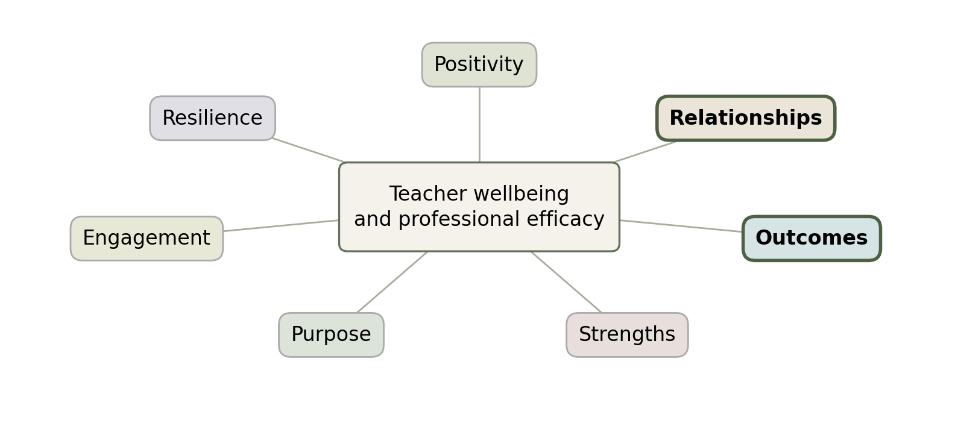
PROSPER connects wellbeing with working conditions
Relationships: reliable support and inclusion
Outcomes and Strengths: credible feedback and achievable work
Resilience: recovery supported by safer conditions
Purpose, Engagement and Positivity: meaningful voice without forced optimism
Noble & McGrath (2015); Datu et al. (2022). .
Notes:
Slide script:
PROSPER gives us seven areas to consider: Positivity, Relationships, Outcomes, Strengths, Purpose, Engagement and Resilience. Let’s think about what these could mean in our working lives.
Relationships might mean knowing that someone will support you at a difficult meeting. Outcomes and Strengths could mean achievable goals and feedback that recognises what you do well. Purpose and Engagement involve having a meaningful voice in our school. Positivity needs room for honest conversations about distress, and Resilience needs opportunities for recovery alongside safer working conditions.
The framework helps organise our thinking, but the evidence has limits. Its original study explored educators’ views of usefulness and some benefits have been reported but not directly for teacher bullying reduction. We still think it will be a helpful starting point.
Let’s try a fictional example. Jordan receives repeated hostile parent messages and is asked to attend a meeting alone. With the person next to you, spend two minutes identifying the PROSPER areas under pressure. Then spend two minutes deciding what the school could change to protect Jordan.
Presenter cue: Allow a further two minutes to share ideas. Possible actions include a support person at the meeting, a managed contact channel and a named person to follow up. The diagram is a teacher-focused adaptation of Noble and McGrath’s framework.
Sources
Datu, J. A. D., Lee, A. S. Y., Fung, W. K., Cheung, R. Y. M., & Chung, K. K. H. (2022). Prospering in the midst of the COVID-19 pandemic: The effects of PROSPER-based intervention on psychological outcomes among preschool teachers. Journal of School Psychology, 94, 66–82. https://pmc.ncbi.nlm.nih.gov/articles/PMC9376344/
Noble, T., & McGrath, H. (2015). PROSPER: A new framework for positive education. Psychology of Well-Being, 5, 2. https://doi.org/10.1186/s13612-015-0030-2

Slide 7
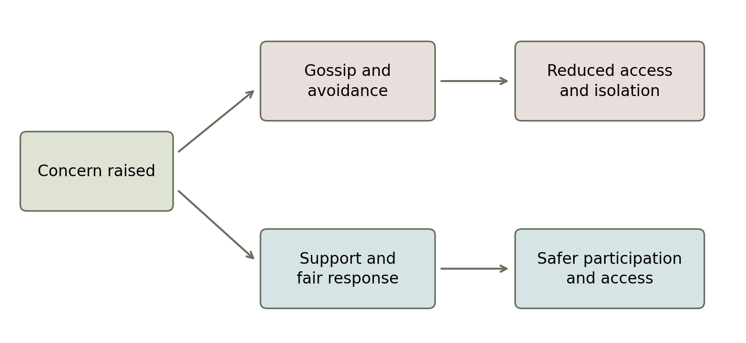
Individual needs and the school’s relationships
Safety, belonging and esteem can be threatened together.
A concern changes what colleagues see, share and feel able to say.
School action: restore access, respond fairly and protect speaking up.
Maslow (1943); Kott (2023); Nielsen et al. (2024). Activity: Sam’s access to planning materials.
Notes:
Slide script:
Maslow gives us another way to think about this. Safety, belonging and professional esteem can all be affected at the same time. You might still care deeply about teaching and feel proud of your work while also feeling unsafe. We do not need to move through a fixed sequence before we deserve support.
Bowen’s Family Systems Theory draws our attention to connections between people. One idea is the triangle: tension between two people draws in someone else. Applied carefully to a workplace, it can help us notice taking sides, gossip or exclusion. Schools have their own formal responsibilities, and this lens must never shift responsibility for bullying onto the person being targeted.
Look at the two possible responses in the diagram. What might colleagues learn if a concern leads to gossip and reduced access? What might they learn if it leads to support and a fair response?
Here is our fictional example: Sam reports repeated insults and then stops receiving planning materials. In small groups, identify one action that changes the pattern without requiring Sam to confront the colleague alone.
Presenter cue: Allow around seven minutes overall. Draw out shared access to materials, private support and an impartial response to the conduct. The diagram illustrates possible responses rather than predicting what any individual will do.
Sources
Kott, K. (2023). Two theorists on work systems: Murray Bowen and Barry Oshry. Systems, 11(3), 138. https://doi.org/10.3390/systems11030138
Maslow, A. H. (1943). A theory of human motivation. Psychological Review, 50(4), 370–396. https://doi.org/10.1037/h0054346
Nielsen, M. B., Einarsen, S. V., Parveen, S., & Rosander, M. (2024). Witnessing workplace bullying: A systematic review and meta-analysis of individual health and well-being outcomes. Aggression and Violent Behavior, 75, 101908. https://doi.org/10.1016/j.avb.2023.101908

Slide 8

Three Suggested PD Activities for your team
1. Strengths-to-practice workshop
Bring a routine teaching challenge. Use the PROSPER framework to think it through. Pool colleagues’ strengths to plan one achievable change, trial it and review together.
2. Peer observation and supportive feedback
Choose a teaching skill, observe a colleague demonstrate it, then adapt and trial the strategy. Meet again to reflect.
3. Wheel of Wellbeing partner check-in
Pair up and ask: How am I going? What needs attention? What small step or support would help? Agree on a follow-up (not necessarily with the same person).
Noble & McGrath (2015); Bandura (1977b); AITSL (n.d.); South Kent Mind (n.d.); Spain et al. (2021)..
Notes:
Slide script:
These are three ideas for ongoing professional learning that supports your teaching practice and wellbeing. We could build them into protected team time, rather than adding another expectation outside working hours.
First is a strengths-to-practice workshop. In a small team, choose a routine teaching challenge, such as making lesson instructions clearer or supporting participation in a group task. Each person contributes one area of expertise or an approach that has helped them. Use those strengths to co-design one achievable change, agree who will trial it and review it together in two weeks. Bring a simple example of what happened so the discussion stays useful. This applies PROSPER’s Strengths, Outcomes and Engagement elements through meaningful professional contribution and achievable progress. It is a proposed application, rather than an activity directly tested by the original PROSPER study. Allow around 20 minutes initially and a short follow-up.
Second is voluntary peer observation and supportive feedback. Agree on a specific teaching skill that the learning teacher wants to develop. An experienced colleague demonstrates it during a short classroom visit or a demonstration within team learning time. The teacher observes what the colleague does, discusses the reasoning behind it and adapts the strategy to their own class. After trying it, the pair meets again to reflect on what worked and what needs adjusting. This uses modelling and observation from Bandura’s Social Learning Theory and AITSL’s guidance on collaborative professional learning. Keep the purpose developmental, agree feedback boundaries beforehand and arrange cover or protected time. It should not become an unexpected appraisal or a way of monitoring a teacher who has reported bullying.
Third is a face-to-face Wheel of Wellbeing partner check-in. Use the six areas of Body, Mind, Spirit, People, Place and Planet as prompts, rather than a test or a required disclosure. Take a quiet minute to consider them, then choose what you feel comfortable discussing with your partner. Ask: “How am I going at the moment?”, “Which area needs more attention?” and “What small step or practical support would help?” Each partner listens, reflects back what they have heard and asks what support would be welcome. Agree when to check in again. Allow around ten minutes, with equal time for each person. Someone may prefer to reflect privately or use a general example.
The Wheel can help open up a conversation about wellbeing, but we should be realistic about the evidence. Spain and colleagues’ Australian study explored the experiences of nine program participants in a focus group. It does not establish that this particular paired exercise improves teacher wellbeing or prevents bullying. These questions are an adaptation for our school.
Together, these activities aim to create opportunities for shared expertise, achievable professional growth and supportive connection. Leadership still needs to address harmful conduct and unsafe work arrangements.
Presenter cue: These replace the earlier presentation-based scenarios. The framework connections belong in these notes rather than as labels on the slide. Review whether the activities are useful and adjust them with staff input.
Sources
Australian Institute for Teaching and School Leadership. (n.d.). High-quality professional learning cycle. https://www.aitsl.edu.au/resources/highquality-professional-learning-cycle
Bandura, A. (1977b). Social learning theory. Prentice Hall. https://www.ncbi.nlm.nih.gov/nlmcatalog/101562611
Noble, T., & McGrath, H. (2015). PROSPER: A new framework for positive education. Psychology of Well-Being, 5, 2. https://doi.org/10.1186/s13612-015-0030-2
South Kent Mind (n.d.) Wheel of Wellbeing image
Spain, D., Stewart, V., Betts, H., & Wheeler, A. J. (2021). Wheel of Wellbeing (WoW) health promotion program: Australian participants report on their experiences and impacts. BMC Public Health, 21, 2037. https://doi.org/10.1186/s12889-021-12076-x

Slide 9
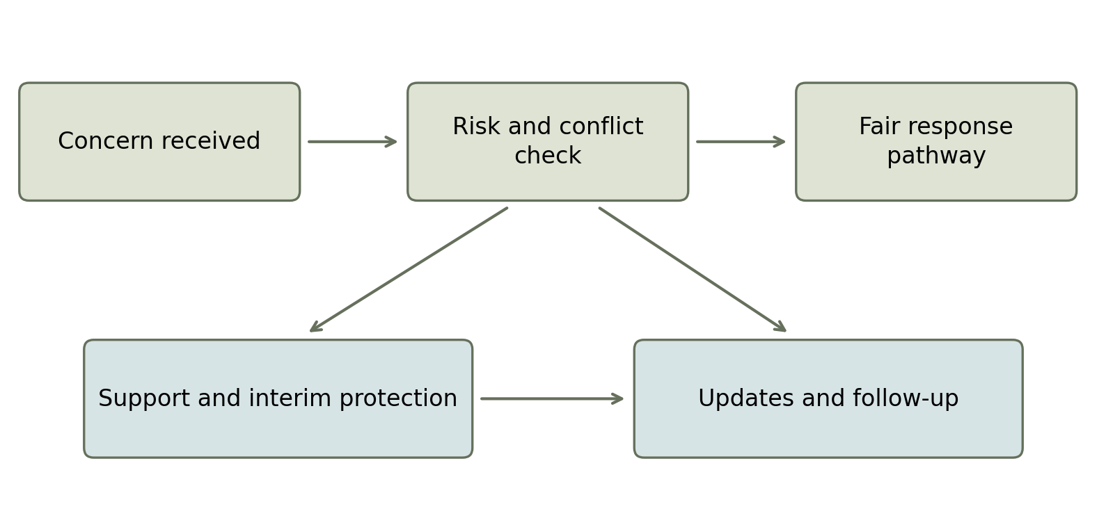
Immediate actions: a visible, supported pathway
1. Clear access
Confirm F01/F02, contacts and an impartial alternative.
2. Early protection
Assess urgent risk and agree safe work arrangements.
3. Reliable updates
Name the handler, next contact date and review options.
Proposed first fortnight: leadership and HR confirm the pathway and test it with a fictional case.
CEDR (2025), sections 20–21. Timeframes and implementation are proposed Wrenvale standards.
Notes:
Slide script:
What would make our reporting process easier to use when someone is already feeling distressed? We have three proposed immediate actions.
First, we need clear access. F01 explains the process, while F02 helps staff record concerns. Staff also need to know who they can approach if the concern involves their immediate leader. The CEDR Code already allows escalation beyond that person. Our proposal makes the pathway easier to find and follow.
Second, someone needs to assess urgent risks promptly and agree on suitable temporary protections. That could include supported meetings or changes to contact arrangements, depending on the situation. A support person can assist, while the authorised handler assesses the concern fairly.
Third, we need reliable communication. F01 proposes acknowledgement within one working day, an explanation of next steps within two, and an initial assessment of non-urgent risks within three. A named handler would give updates at least every five working days and explain the next contact date. These are proposed Wrenvale standards requiring appropriate approval.
Turn to the person next to you. Let’s discuss and briefly think through a response if your colleague lets you know about an experience they have had : “Thank you for telling me. What would help you feel safer today? Would you like support contacting the appropriate person?” We can listen and explain the next step without promising secrecy or a particular finding.
Presenter cue: Allow around seven minutes. Ask pairs to rehearse briefly as to what words sound natural for them, then identify who would own the next action. Ask for a few groups to provide a summary, especially if it relates to updating the Wrenvale process, or what might help staff when they disclose.
Sources
Catholic Education – Diocese of Rockhampton. (2025). Staff code of conduct (Version 7, October 2025). https://os-data-2.s3-ap-southeast-2.amazonaws.com/rok-catholic-edu-au/bundle9/Staff%20Code%20of%20Conduct%20Version%207%20October%202025.PDF
WorkSafe Queensland. (n.d.). Bullying. https://www.worksafe.qld.gov.au/safety-and-prevention/mental-health/Psychosocial-hazards/bullying

Slide 10
PROSPER(E): a proposed Wrenvale adaptation
School actions to reduce bullying, with evaluation built in
Relationships and Resilience
E = Evaluate school actions
Stop exclusion, support difficult meetings and agree safer contact and recovery arrangements.
Listen, act, review and refine
Strengths and Outcomes
Check staff safety, confidence in reporting, repeated harm and response times.
Restore access to resources, recognise expertise and use fair, constructive feedback.
Positivity, Purpose and Engagement
Name an owner. Review each term with confidential staff input and adjust actions.
Make room for honest concerns and involve staff in decisions and shared standards.
.
Noble & McGrath (2015); Kollerová et al. (2023); Amoadu et al. (2024); Skivington et al. (2021)
Notes:
Slide script:
We have talked about how PROSPER can help us think about teacher wellbeing. Our proposed Wrenvale adaptation adds an E for Evaluation. We would keep the seven original dimensions and build a review loop around the school’s actions.
What would that look like if our priority is reducing bullying? For Relationships and Resilience, we could address exclusion, provide support at difficult meetings and agree safer contact arrangements. Recovery is easier to support when the harmful behaviour is also being addressed. Kollerová and colleagues found that bullying was associated with greater exhaustion, while leadership support was associated with less exhaustion.
For Strengths and Outcomes, we could restore access to shared resources, recognise teachers’ expertise and make feedback constructive and fair. For Positivity, Purpose and Engagement, we need space for honest concerns and staff involvement in decisions. A positive culture should make it easier to raise harm, rather than creating pressure to appear happy or keep the peace. These are proposed applications of PROSPER, rather than actions proven effective by the original framework study.
The E asks us to check what changes in practice. Before making changes, we could gather confidential feedback about safety, exclusion and confidence in reporting. We would then introduce the agreed actions and review whether harmful behaviour is continuing, whether responses are timely and whether staff feel supported. A named leader would be responsible for the actions, with a review date each term and earlier follow-up where risks continue.
If there is a perceived change we will need to ask why and evaluate. Has the behaviour reduced, or do people feel less able to report it? We need staff experiences alongside the numbers. Skivington’s evaluation guidance supports involving stakeholders, considering the setting and refining actions. Amoadu’s review also supports visible management attention to psychological health and prevention of mistreatment, although it covers workplaces beyond schools.
Ask: Which of these changes would make the biggest practical difference here, and what would tell us that it was helping?
Presenter cue: Allow around four minutes, including brief responses. This E is a proposed local addition.
Sources
Amoadu, M., Ansah, E. W., & Sarfo, J. O. (2024). Preventing workplace mistreatment and improving workers’ mental health: A scoping review of the impact of psychosocial safety climate. BMC Psychology, 12, 195. https://doi.org/10.1186/s40359-024-01675-z
Kollerová, L., Květon, P., Zábrodská, K., & Janošová, P. (2023). Teacher exhaustion: The effects of disruptive student behaviors, victimization by workplace bullying, and social support from colleagues. Social Psychology of Education, 26, 885–902. https://doi.org/10.1007/s11218-023-09779-x
Noble, T., & McGrath, H. (2015). PROSPER: A new framework for positive education. Psychology of Well-Being, 5, 2. https://doi.org/10.1186/s13612-015-0030-2
Skivington, K., Matthews, L., Simpson, S. A., Craig, P., Baird, J., Blazeby, J. M., Boyd, K. A., Craig, N., French, D. P., McIntosh, E., Petticrew, M., Rycroft-Malone, J., White, M., & Moore, L. (2021). A new framework for developing and evaluating complex interventions: Update of Medical Research Council guidance. BMJ, 374, n2061. https://doi.org/10.1136/bmj.n2061

Slide 11
Putting the plan into practice
Start this term
Leadership and HR confirm responsibilities, time and resources, then trial the pathway with staff input.
Keep professional learning going
Use termly case discussions and reporting practice, new-staff induction and training for leaders.
Evaluate progress and adjust
Compare baseline and termly feedback on safety, repeated harm and response quality, alongside process data.
Key message for Wrenvale
Valuing staff wellbeing means visible action, reliable follow-through and continuing review.
Proposed implementation: Amoadu et al. (2024); Skivington et al. (2021); WorkSafe Queensland (n.d.)
Notes:
Slide script:
We have the framework and proposed reporting pathway. The next question is how we make them work consistently in everyday school life.
Our first step this term would be for leadership and HR to confirm who does what, what time and resources are available, and how staff can access an impartial alternative contact. We could test the pathway with a fictional case and use staff feedback to identify confusing steps before relying on it in a real situation. These actions and dates are proposals that need appropriate employer review and approval.
Professional learning should continue beyond today. Short, protected sessions each term could revisit recognising harmful conduct, responding to disclosures and practising the reporting process. New staff would receive an induction, and leaders would need preparation in fair responses, interim protections and reliable communication. We would check whether staff can apply what they learn, rather than simply recording attendance.
How would we know the plan is helping? We could begin with confidential staff feedback and compare it with later feedback on safety, repeated harmful behaviour and confidence in getting a fair response. Process information could show whether acknowledgements, updates and follow-up checks occur when expected. We would also ask whether the protections actually help the person affected. Success would involve less continuing harm and more reliable support, interpreted alongside staff experiences.
The evaluation lead would bring de-identified findings to a termly review with staff representatives. Leadership would explain what is changing, who is responsible and when it will be checked again. Urgent concerns would still need prompt attention between reviews. Skivington’s guidance supports this attention to context, stakeholders and refinement, while Amoadu’s review supports visible management commitment to psychological health. These sources inform our proposal; they do not establish that this particular timetable or training package will prevent bullying.
The key message for Wrenvale is that valuing wellbeing has to show up in our actions and follow-through. Staff should be able to see how their feedback leads to safer work.
Presenter cue: Allow around four minutes. Invite one suggestion for making the plan practical within existing school routines. Keep individual complaints outside the group discussion.
Sources
Amoadu, M., Ansah, E. W., & Sarfo, J. O. (2024). Preventing workplace mistreatment and improving workers’ mental health: A scoping review of the impact of psychosocial safety climate. BMC Psychology, 12, 195. https://doi.org/10.1186/s40359-024-01675-z
Skivington, K., Matthews, L., Simpson, S. A., Craig, P., Baird, J., Blazeby, J. M., Boyd, K. A., Craig, N., French, D. P., McIntosh, E., Petticrew, M., Rycroft-Malone, J., White, M., & Moore, L. (2021). A new framework for developing and evaluating complex interventions: Update of Medical Research Council guidance. BMJ, 374, n2061. https://doi.org/10.1136/bmj.n2061
WorkSafe Queensland. (n.d.). Bullying. https://www.worksafe.qld.gov.au/safety-and-prevention/mental-health/Psychosocial-hazards/bullying

Slide 12
Where to individually from here?
Reach out if today has raised concerns
Speak privately with a presenter, trusted colleague or counselling service. Ask about independent support.
Know the definitions and pathway
Read F01 and F02. Know who you can approach and how to raise a concern privately.
Check what drains and restores your energy
Identify one manageable change and talk with a supportive colleague about the practical help you need. Talk to your trusted colleague and team about team actions as needed- this is a group effort.
Keep the conversation going
Arrange a check-in. Talk in your team about bullying and other behaviours that affect wellbeing.
Seek professional support if distress continues or affects daily life.
Your wellbeing is highly valued at Wrenvale. You deserve to feel safe, supported and heard.
Support and reporting: WorkSafe Queensland (n.d.); CEDR (2025). .
Notes:
Slide script:
Before we finish, let’s think about what might be useful for you individually. Your wellbeing is highly valued at Wrenvale. You deserve to feel safe, supported and heard. Although we are identifying bullying as a whole school concern, your individual wellbeing is what we are hoping to help you protect.
If anything today has worried you or brought up something personal, you are welcome to speak privately with one of us. You could also approach a trusted colleague or seek counselling or independent support. You can choose how much you share. A colleague can help you find the appropriate support or reporting contact, rather than being expected to investigate or resolve the concern.
Take a few minutes to become familiar with the definitions and with F01 and F02 on the website and available on the Wrenvale intranet. Knowing the pathway beforehand can make it easier to find the right contact if something happens. You can ask for a private conversation before deciding whether to complete a form. If you choose to record a concern, focus on what happened and use the private process described in the guidance.
You might also do a simple energy check-in: what is taking the most out of you at the moment, and what helps you recover or feel more connected? Consider one manageable change, such as protecting a break, agreeing clearer contact arrangements or asking for practical support with a demanding task. Talk it through with a supportive colleague if that feels helpful, and arrange a time to check back in.
If distress is continuing or affecting sleep, work or life outside school, consider professional support. You do not have to wait until things feel unmanageable to ask for help.
These personal steps sit alongside the school’s responsibility to address harmful conduct and make work safer. Looking after yourself does not make you responsible for stopping someone else’s bullying.
Thank you for the work you do and for contributing to a safer Wrenvale community.
Presenter cue: Allow a quiet minute for reflection. Invite staff to identify one next step privately, without requiring them to share personal information.
Sources
Catholic Education – Diocese of Rockhampton. (2025). Staff code of conduct (Version 7, October 2025). https://os-data-2.s3-ap-southeast-2.amazonaws.com/rok-catholic-edu-au/bundle9/Staff%20Code%20of%20Conduct%20Version%207%20October%202025.PDF
WorkSafe Queensland. (n.d.). Bullying. https://www.worksafe.qld.gov.au/safety-and-prevention/mental-health/Psychosocial-hazards/bullying

Slide 13
Sources and resources
Sources are identified on each slide and can also be found on the Home page of the Wrenvale website.
Support services
Beyond Blue
WorkSafe Queensland
Mental health information and support
Workplace bullying guidance
Lifeline
WorkingWell – CatholicCare
Crisis support
Employee assistance and counselling
1800RESPECT
Relationships Australia Bundaberg
Domestic, family and sexual violence support
Counselling and relationship support
eSafety Commissioner
Phoenix House Bundaberg
Online harm advice and reporting
Counselling
IEU Queensland & NT
Workplace advice and representation
Reporting forms
F01: Reporting guideline (PDF)
F02: Staff reporting form (PDF)
.
Notes:
Slide script:
The sources for this presentation are identified on each slide, with fuller details in the notes. You can also find the reference list on the Home page of this website.
This slide brings together the nine support services listed in our website directory. Click a service name to open its website. There are options for mental health support, family and relationship support, online harm advice, workplace guidance and representation. WorkingWell is CatholicCare’s employee assistance service; the provider can explain eligibility and access. Ask the relevant provider about service arrangements and suitability for your needs.
The two form links are below. F01 explains the proposed reporting process. F02 is the blank staff reporting form for printing and private completion. The links open the PDFs supplied with this presentation. Keep the PowerPoint and both PDFs together in the extracted folder so the links continue to work.
If you would like a private conversation about anything raised today, please speak with one of the presenters- the conversation doesn’t have to be with us, we can link you as needed.
Thank you for taking part and for the care and expertise you bring to Wrenvale.
Sources
1800RESPECT. (n.d.). Coercive control. https://1800respect.org.au/coercive-control
Amoadu, M., Ansah, E. W., & Sarfo, J. O. (2024). Preventing workplace mistreatment and improving workers’ mental health: A scoping review of the impact of psychosocial safety climate. BMC Psychology, 12, 195. https://doi.org/10.1186/s40359-024-01675-z
Arnsten, A. F. T. (2009). Stress signalling pathways that impair prefrontal cortex structure and function. Nature Reviews Neuroscience, 10, 410–422. https://doi.org/10.1038/nrn2648
Australian Institute for Teaching and School Leadership. (n.d.). High-quality professional learning cycle. https://www.aitsl.edu.au/resources/highquality-professional-learning-cycle
Bandura, A. (1977a). Self-efficacy: Toward a unifying theory of behavioral change. Psychological Review, 84(2), 191–215. https://doi.org/10.1037/0033-295X.84.2.191
Bandura, A. (1977b). Social learning theory. Prentice Hall. https://www.ncbi.nlm.nih.gov/nlmcatalog/101562611
Catholic Education – Diocese of Rockhampton. (2025). Staff code of conduct (Version 7, October 2025). https://os-data-2.s3-ap-southeast-2.amazonaws.com/rok-catholic-edu-au/bundle9/Staff%20Code%20of%20Conduct%20Version%207%20October%202025.PDF
Datu, J. A. D., Lee, A. S. Y., Fung, W. K., Cheung, R. Y. M., & Chung, K. K. H. (2022). Prospering in the midst of the COVID-19 pandemic: The effects of PROSPER-based intervention on psychological outcomes among preschool teachers. Journal of School Psychology, 94, 66–82. https://pmc.ncbi.nlm.nih.gov/articles/PMC9376344/
Kollerová, L., Květon, P., Zábrodská, K., & Janošová, P. (2023). Teacher exhaustion: The effects of disruptive student behaviors, victimization by workplace bullying, and social support from colleagues. Social Psychology of Education, 26, 885–902. https://doi.org/10.1007/s11218-023-09779-x
Kott, K. (2023). Two theorists on work systems: Murray Bowen and Barry Oshry. Systems, 11(3), 138. https://doi.org/10.3390/systems11030138
Maslow, A. H. (1943). A theory of human motivation. Psychological Review, 50(4), 370–396. https://doi.org/10.1037/h0054346
McFarland, L., Bull, R., Cumming, T., & Wong, S. (2024). Workplace bullying in early childhood education settings: Prevalence and protective factors. International Journal of Early Childhood, 56, 189–210. https://doi.org/10.1007/s13158-022-00341-y
Moon, B., Saw, G., McCluskey, J., & Vasquez, H. (2026). Victimized online: Impact on teachers’ work stress, job inefficacy, and turnover intentions. Journal of School Violence. Advance online publication. https://doi.org/10.1080/15388220.2026.2640132
Nielsen, M. B., Einarsen, S. V., Parveen, S., & Rosander, M. (2024). Witnessing workplace bullying: A systematic review and meta-analysis of individual health and well-being outcomes. Aggression and Violent Behavior, 75, 101908. https://doi.org/10.1016/j.avb.2023.101908
Noble, T., & McGrath, H. (2015). PROSPER: A new framework for positive education. Psychology of Well-Being, 5, 2. https://doi.org/10.1186/s13612-015-0030-2
Skivington, K., Matthews, L., Simpson, S. A., Craig, P., Baird, J., Blazeby, J. M., Boyd, K. A., Craig, N., French, D. P., McIntosh, E., Petticrew, M., Rycroft-Malone, J., White, M., & Moore, L. (2021). A new framework for developing and evaluating complex interventions: Update of Medical Research Council guidance. BMJ, 374, n2061. https://doi.org/10.1136/bmj.n2061
Spain, D., Stewart, V., Betts, H., & Wheeler, A. J. (2021). Wheel of Wellbeing (WoW) health promotion program: Australian participants report on their experiences and impacts. BMC Public Health, 21, 2037. https://doi.org/10.1186/s12889-021-12076-x
Varela, J. J., Álamos, P., Guzmán, P., Marsollier, R., Exposito, C., Romo, F., López, C., & Miranda, R. (2025). Cyberbullying against teachers in Latin America during the pandemic: The negative effects on their levels of well-being through burnout. Journal of School Violence, 24(3), 446–460. https://doi.org/10.1080/15388220.2025.2483270
Wathen, C. N., MacGregor, J. C. D., & MacQuarrie, B. J. (2015). The impact of domestic violence in the workplace: Results from a pan-Canadian survey. Journal of Occupational and Environmental Medicine, 57(7), e65–e71. https://pmc.ncbi.nlm.nih.gov/articles/PMC4676385/
WorkSafe Queensland. (n.d.). Bullying. https://www.worksafe.qld.gov.au/safety-and-prevention/mental-health/Psychosocial-hazards/bullying
Resources
Beyond Blue: https://www.beyondblue.org.au/
Lifeline: https://www.lifeline.org.au/
1800RESPECT: https://1800respect.org.au/
eSafety Commissioner: https://www.esafety.gov.au/report
IEU Queensland & NT: https://ieuqnt.org.au/
WorkSafe Queensland: https://www.worksafe.qld.gov.au/safety-and-prevention/mental-health/Psychosocial-hazards/bullying
WorkingWell – CatholicCare: https://catholiccarecq.com/services/workingwell-employee-assistance-program/
Relationships Australia Bundaberg: https://raq.org.au/locations/bundaberg/
Phoenix House Bundaberg: https://phoenixhouse.com.au/
F01 Reporting guideline: F01_Reporting_Guideline.pdf
F02 Staff reporting form: F02_Staff_Reporting_Form.pdf
Both PDFs are included in the accompanying folder. They are also available from the Policies and reporting section of the Wrenvale website.

